Slide 1
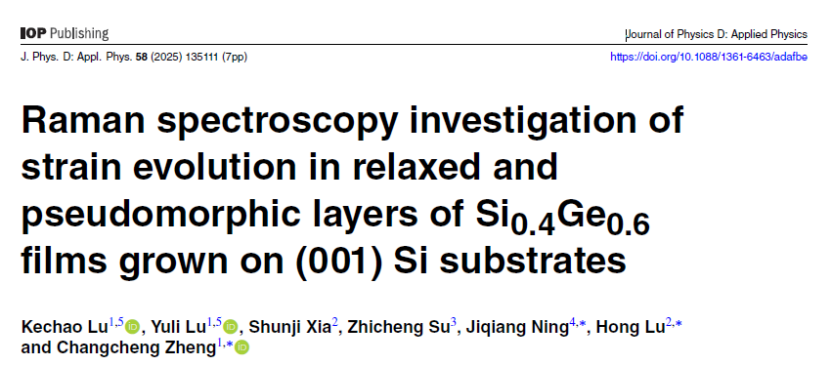
Plan in advance; Get a plan B; Collaboration
changcheng.zheng@dukekunshan.edu.cn
0512- 36657558
WDR3012
Recent research project(s)/SW project(s)/publication(s)
Changcheng Zheng
Optics and nanomaterials

